Slide 1
OSU Schedulizer
Presented by:
The Web Ninjas

Slide 2
What is the OSU Schedulizer?
Plan out classes to take
Check instructor quality
See what classes meet your gradation requirements

Slide 3
Why did we make the OSU Schedulizer?
The Web Ninjas wanted a centralized place to plan out classes, check instructors, and see gradations requirements.
No need to have 3 websites open at once: CSE Department, Buckeyelink, and Rate My Professor.

Slide 4
What does it look like?
DEMO TIME!
:-)

Slide 5
Our thoughts behind the design
Simple and Minimalistic
4 Main Pages
Favorites
Search
Degree Requirements
Edit Profile
About Us Page

Slide 6
Design
Code Reuse
Partials and Embedded Ruby
Partials allow for code reuse in common page elements (e.g., a navbar)
Embedded Ruby allows for dynamic code changes based on code execution
Partial example:
Partial Example:
<%= link_to(about_aboutus_path, :class => 'item') do%>
<i class="info circle icon"></i>AboutUs
<% end %>

Slide 7
Styling
Styling tools used:
Semantic UI
Frontend framework that allows for easy addition of UI components
Modular
Components Required:
Gulp
Node.js
jQuery
CSS
Custom CSS classes used:
Style.css
navbar.css

Slide 8
How does it work?
MVC design
Model
View
Controller
Web Scraping
Devise
Rails

Slide 9
Web Scraping
Functionality lies in seeds.rb
Utilized Mechanize gem in order to navigate to ratemyprofessor.org and save a mech object based on a professor’s name.
Use link to gather rating on professor’s page.
Aggregate them in the view using embedded ruby.

Slide 10
How we used Devise
Devise is used for user authentication and authorization along with secure password storage.
Gems we utilized
Registerable
Rememberable
Database Authenticatable
Devise.rb allows for configuration
config.reset_password_within = 6.hours
config.email_regexp = /\A[^@\s]+@[^@\s]+\z/
config.password_length = 6..128

Slide 11
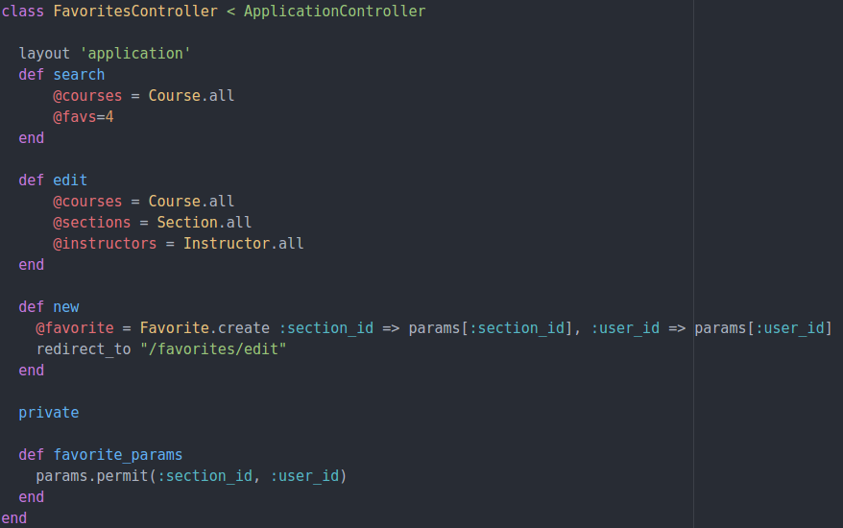
How did we interact with the Database?
Made global variables in the Controller.

Slide 12

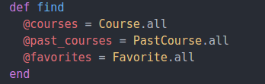
How did we pull info from our Database?
By storing databases in global variables in the Controller, they were accessible using Ruby in the View.

Slide 13
What’s the algorithm behind “required courses”?
Loop through courses in CSE department
If required for gradation, print to screen
If class is in user’s past classes, print in green
Otherwise, print in red
Special Case: “OR” course requirements
Move through “OR” classes
If Class A || Class B in user’s past courses, print in green
Otherwise, print in red

Slide 14
Things we would have done differently
It is always beneficial to look back on ways we can improve…
What did we learn?
Start the project sooner
Make the code flexible so adding and removing features is simple
Break the work up into separate testable modules

